Slide 1
CERTIS ONCOLOGY
IHC-Validated Antibodies

Slide 2
65+ IHC-VALIDATED ANTIBODIES
A-C | C | E-G | H-L | M-P | P-T | T-W
Alk | CD34 (QBEnd/10) | EGFR Viii | HER-2/G20586 | MUC13 (E6Z1K) | PDL-1 (E1L3N) | TTF1
Anti-ATM (Ataxia-telangiectasia mutated gene) | CD4 Ab-8 | EpCAM | HLA-1 ABC | Nectin 4 | Progesterone Receptor (PR) | VEGF
Anti-Met (C-Met) [CAL12] | CD68 | ErbB3/Her-3, [SP71] | Human Gangliosides (GD2) (14.G2a) | NMDAR1 | PSMAD3 (Phospho S423 + S425) | Vimentin
Anti-p-Rb-Ser807/811 Antibody, Rabbit Monoclonal | CD8 Ab-1 | ERG [EPR3864] | Human Nucleoli | NY-ESO-1 | Rabbit anti-human NCAM1 [EPR2566] (CD56) | WT-1
BRST2/GCDFP-15 | CDX2 [CDX2/1690] | Estrogen receptor Alpha (ER) | GF1 Receptor (Phospho Y1161) | P16 | Rabbit monoclonal [SP71], ErbB3/Her-3 | αSMA (Alpha Smooth Muscle Actin)
CAMTA1 | Chromogranin-A [CHGA/1731R] | FAP-Alpha [EPR20021] | IL13 RA2/CD21342 (E7U78) | P40 | Recombinant anti-Rb (phospho T821) [RP23040072]
CD11c | CK19 | FoxP3 | Interferon gamma (IFNG) [IFNG/3996R] | P63 [TP63/2428] | ROR-1
CD206/MRC1 (E6T5J) | CK20 | GATTA3 | Ki67 | Pan Cytokeratin (AE1/AE3) | SOX-10
CD3 | CK5/6 | GFAP | Liv-1/ZIP6 | Pan Lymphoma cocktail (LCA + CD20 + CD3 + CD43) | Synaptophysin (SYP/3551)
CD31 (PECAM-1), (Rabbit) | CK7 | Granzyme B | Mesothelin (D9R5G) XP | PAX8 | TCF1/TCF7
CD31, (Mouse) | Cleaved Caspase-3 | GRPR (Gastric Releasing peptide Receptor) | Mouse anti-Desmin | PD-1 EPR4877(2) | Trop 2

Slide 3
Emphasizing Precision, Striving for Certainty
CERTISAI
Select optimal cancer models for in vitro and in vivo validation ​
Identify predictive biomarkers
Uncover biological pathway MOA
Rank cancer types most likely to respond to candidate​
Elucidate synergistic potential of combinatory therapies​
Develop stratification strategies for patient selection​
Prioritize compound libraries
Assess value of intellectual property​
CUSTOM MODELS
Orthotopic PDX
Subcutaneous PDX
Humanized (PBMC or CD34)
CDX cell lines
Metastatic
Resistant
Radiation (precision and whole body)
PDX-derived 3D spheroids
IN VIVO
Efficacy
Tolerability
PK/PD
Co-clinical trials
ENDPOINTS
MRI
BLI
Histology
Spectral flow cytometry
IncuCyte® live cell imaging
MSD®
HTRF
ELISA
Immunoassays
cfDNA
IN VITRO/EX VIVO
3D cell cultures
Catalog cell lines
Client-supplied cell lines
3

Slide 4
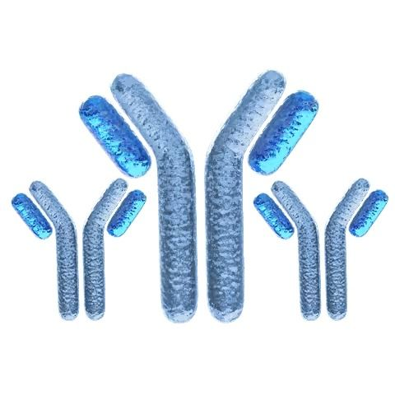
SPEAK TO A SCIENTIFIC EXPERT TODAY
(858) 988-1033
ASK US ABOUT
CUSTOM ANTIBODY VALIDATION
busdev@certisoncology.com
Book a Meeting
Learn More

